Slide 1
Azure Cloud Presentation
By: Shawn C.

Slide 2
What is delay-insensitive, interactive, and unknown?
Workload class
Interactive – identified by a diurnal cycle (people sleep at night and awake during the day)
Delay-insensitive – background workloads (continuous), sometimes have periodic intervals
Unknown – Machines that have not run 3 days
Tested using Fast Fourier Transform (FFT) algorithm
Targets virtual machines that have run longer

Slide 3
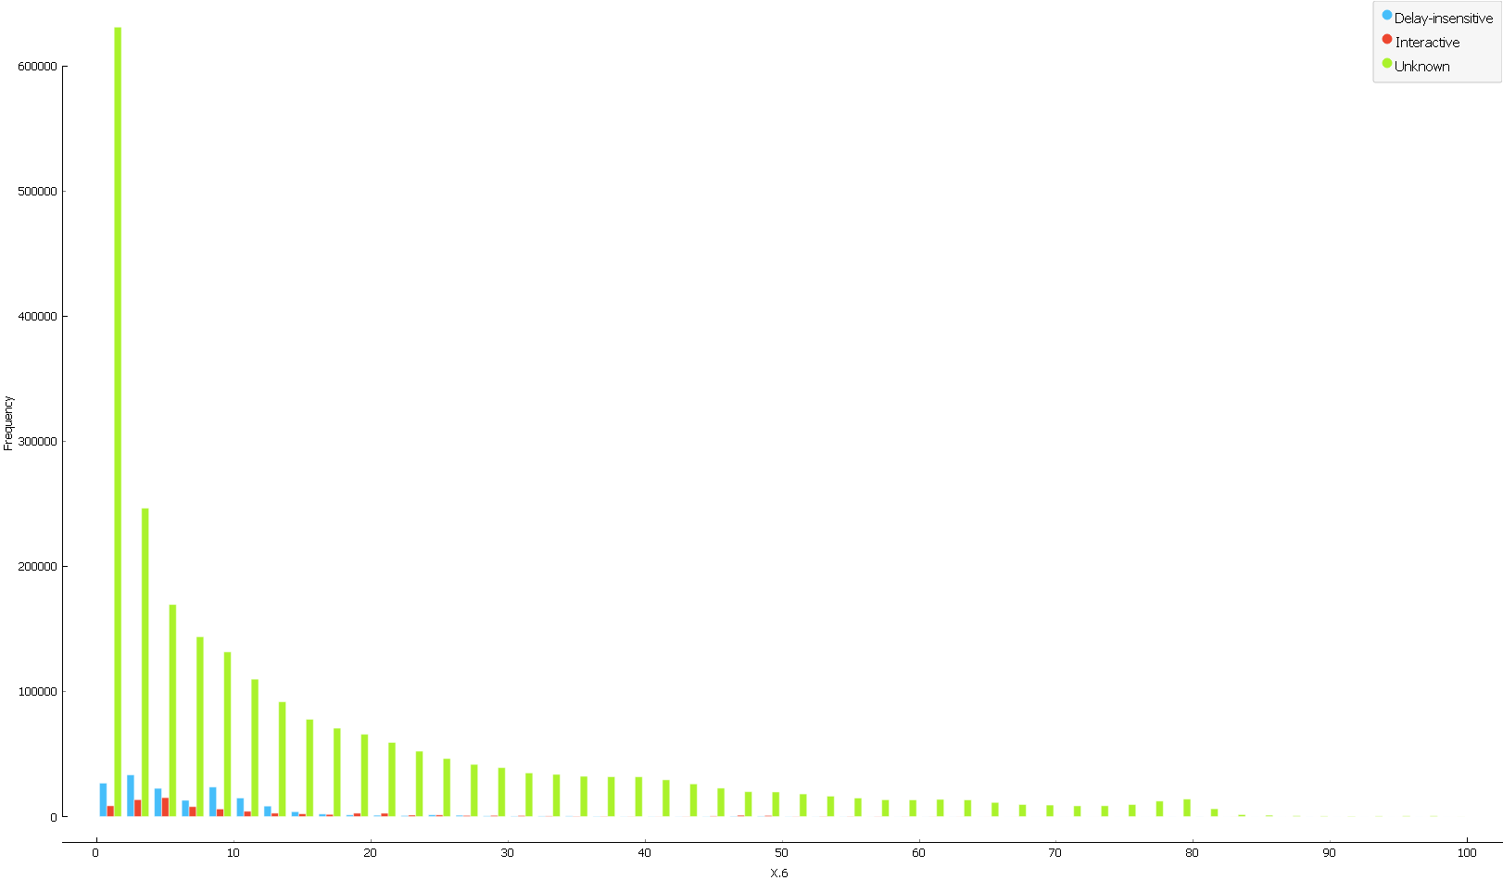
Avg CPU vs Workload Class

Slide 4
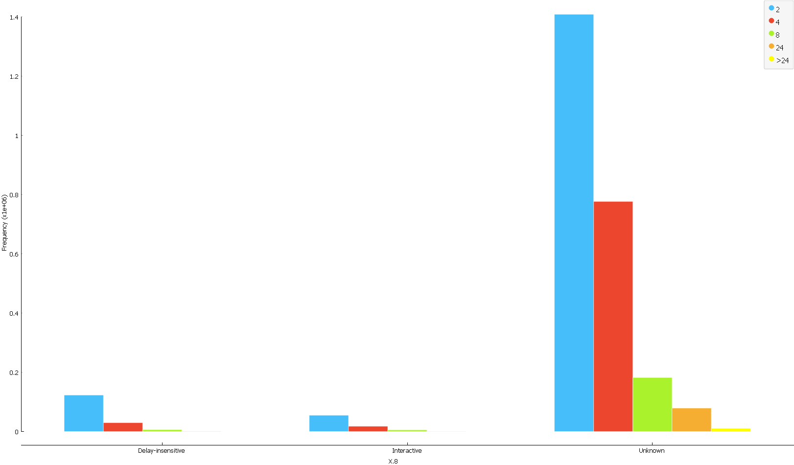
Workload Class vs Core

Slide 5
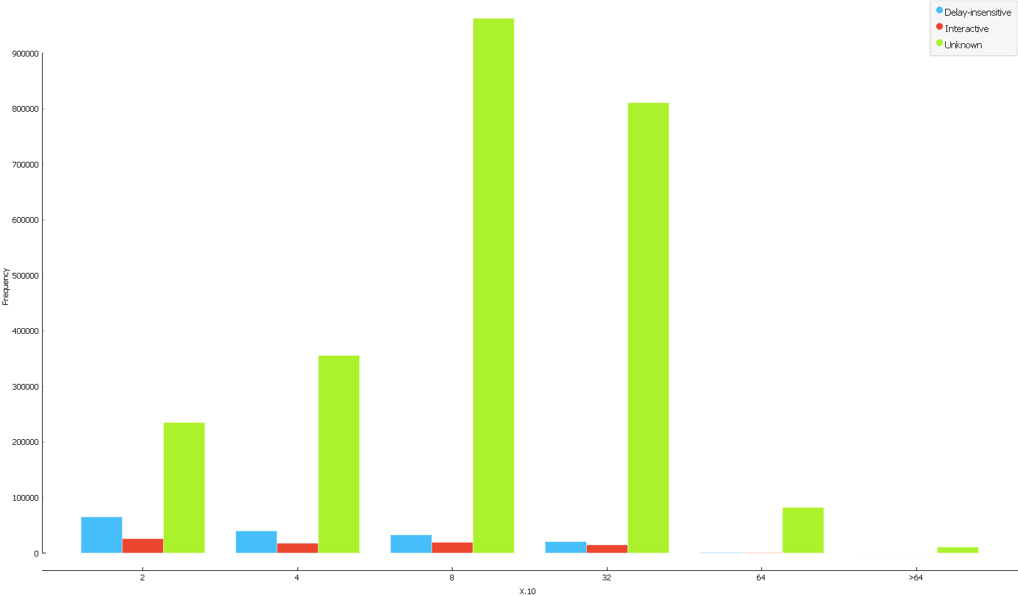
Workload Class vs Memory

Slide 6
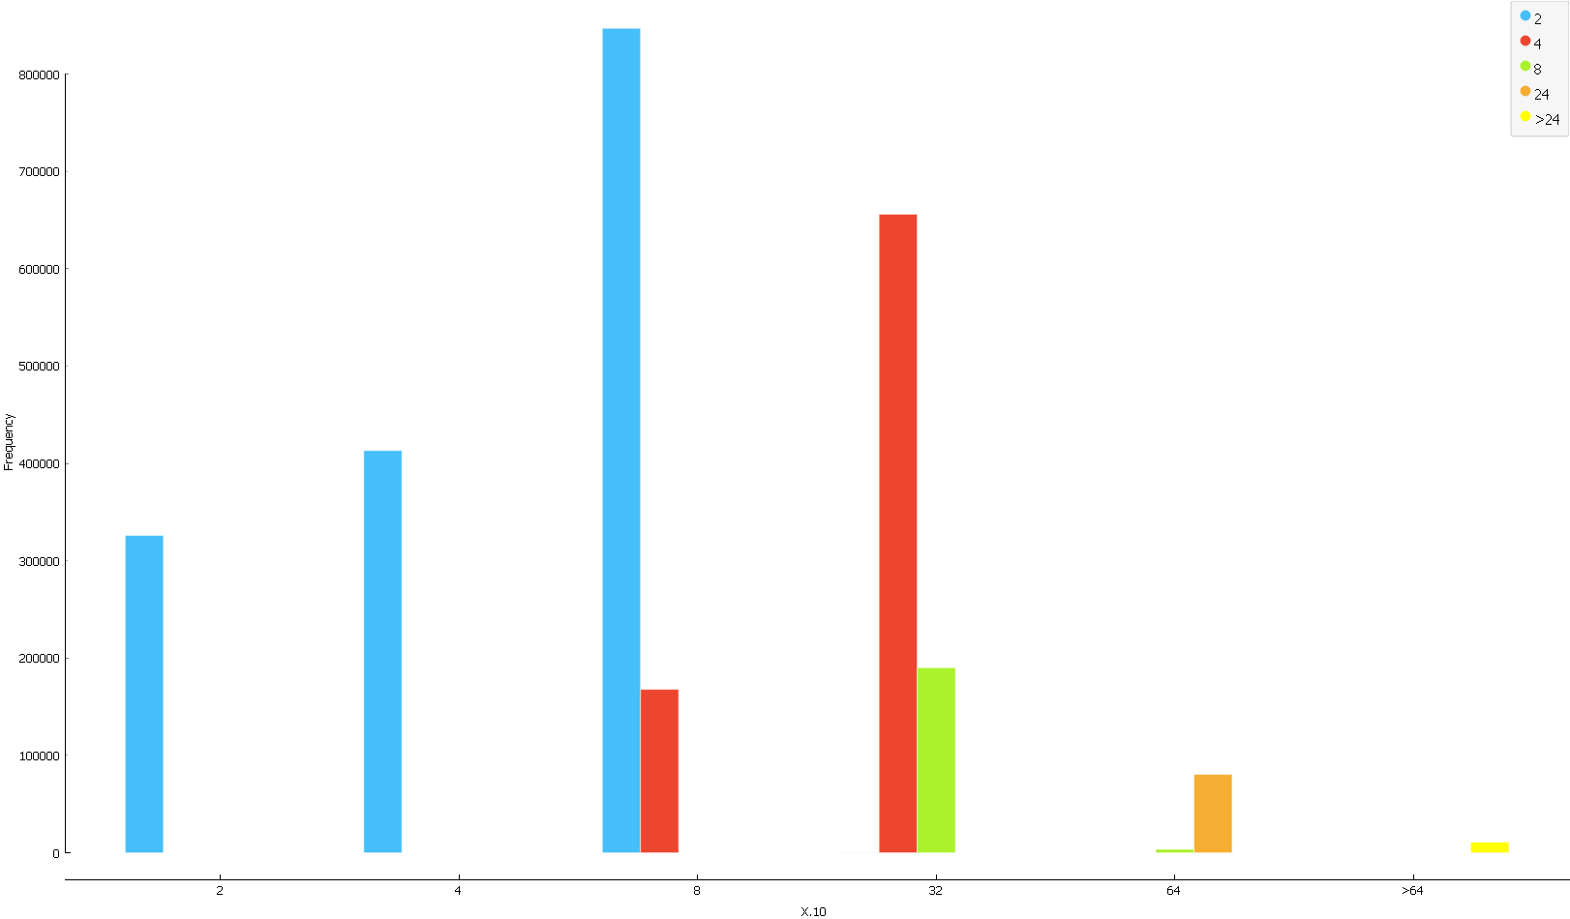
Core vs Memory

